Slide 1


caArray User Community Meeting
caArray User Community Meeting
2.2.0 Feature Overview and Review of MAGE-TAB Update and Export Specification
2.2.0 Release Demonstration
Call in: 877-416-5524
Participant Passcode: 2627056
Centra: http://ncicb.centra.com
Meeting ID: ICR_meeting
November 5, 2008
Call in: 877-416-5524
Participant Passcode: 2627056
Centra: http://ncicb.centra.com
Meeting ID: ICR_meeting
January 7, 2009

Slide 2
Agenda
Demo of new functionality in 2.2.0
Update on next release: 2.3.0
Announcements
Q&A

Slide 3
Upcoming release: 2.2.0
Schedule
  Scheduled to be released on January 21, 2009 - CBIIT installation and local installation packages
Scope
  [#14162] Sample search
  [#16627] MAGE-TAB export
  [#16411] Bulk update of experiment annotations using MAGE-TAB
  [#15409] Enhanced usability of permissions management workflow
  [#17560, 17701] Support for GEO and ScanArray data
  Enhancement of GUI installer to make properties configurable
Detailed Scope
  Filter Implementation Items tracker items by target_release=2.2.0 for detailed visibility into total scope:
  https://gforge.nci.nih.gov/tracker/?atid=1344&group_id=305&func=browse

Slide 4
2.2.0 Demo

Slide 5
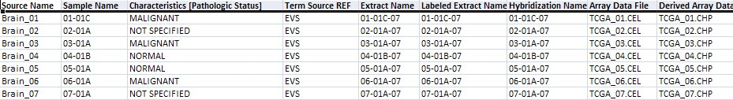
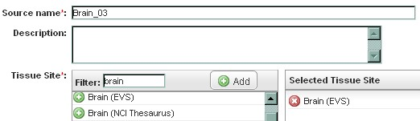
Generate and Export MAGE-TAB
Consolidates annotations from multiple imports and UI changes.

Slide 6
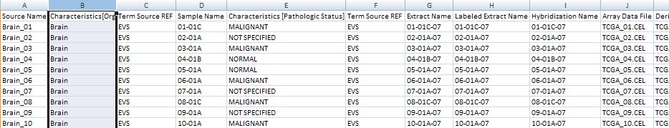
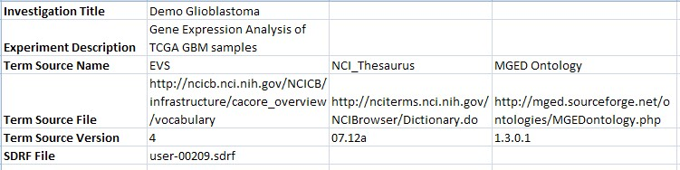
Generate and Export MAGE-TAB
Output = SDRF + IDF

Slide 7
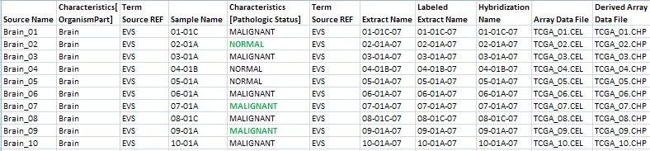
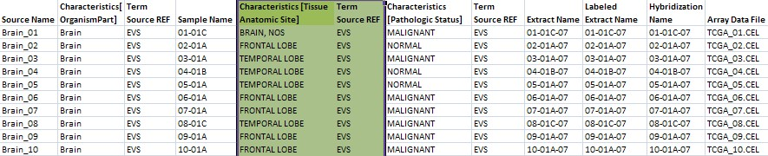
Bulk-update through MAGE-TAB
Change existing characteristics:
Add new characteristics:

Slide 8
Bulk-update through MAGE-TAB
Add more samples but link to existing Source:
Can reuse any biomaterials.
Additive changes to linkages and nodes are allowed, but no deletions.

Slide 9
In progress, for 2.3.0 release:
[#15168] Secure access through the Grid API
[#15578] Redesign of programmatic API
  Updated model was reviewed at the ICR Analytical Services Best Practices Workspace meeting on November 10, 2008.
  Paves the way for backwards compatibility
  Transition all users to the Grid API
  Rich set of caGRID analytical services to provide a quick and convenient way to get to data of interest (avoiding tedious traversal of domain object graph).
Detailed Scope
  Filter Implementation Items tracker items by target_release=2.3.0 for detailed visibility into total scope:
  https://gforge.nci.nih.gov/tracker/?atid=1344&group_id=305&func=browse

Slide 10
Announcements
Knowledgebase (KB) for caArray at the Molecular Analysis Tools Knowledge Center (MATKC)
  URL: https://cabig-kc.nci.nih.gov/Molecular/KC/index.php/CaArray#caArray_Knowledge_Base
  Scalable, searchable, stable
  Current status:
    MATKC has started to post FAQ entries into the KB
    Users can now post comments on KB entries in MATKC caArray forum
  Coming soon:
    A separate section in the KB for user-developed provisional KB entries, which will be subsequently reviewed and promoted by MATKC

Slide 11
Announcements
geWorkbench-caArray connectivity issue is resolved
  Issue: For some users, geWorkbench may time-out when retrieving hybridization data from caArray using caArray API
  Current status:
    The cause has been identified
    A temporary patch is available at MATKC for users who do not want to wait for the next geWorkbench release
    The fix will be included in the next geWorkbench release in January 2009
    Please contact Zhong Li at zli@c2b2.columbia.edu for the patch

Slide 12
Avenues for Feedback
Molecular Analysis Tools Knowledge Center Forum
  Questions and comments that were previously submitted to the caArray_Users and caArray Developers listservs should now be submitted to the corresponding forums at the Molecular Analysis Tools Knowledge Center
  We welcome and encourage active exchanges on the forums to share experiences with the product
GForge Community Change Request tracker:
  http://gforge.nci.nih.gov/tracker/?atid=1339&group_id=305&func=browse
This meeting
Next Meeting:
Wednesday, February 4, 2:00 PM ET

Slide 13
Additional 2.2.0 Detail

Slide 14
MAGE-TAB Export
Experiment annotations can be exported into MAGE-TAB format:
  Current state of the experiment is captured in the generated IDF and SDRF. (Captures annotations from all previous MAGE-TAB imports as well as changes made through the Annotations UI.)
  Includes biomaterial-hybridization-data chains.
  Includes all biomaterial characteristics.
  Includes experiment title, description and term sources.
Not yet captured in the export:
  Experimental factors, protocols.
  Publications, persons, dates.
  Experimental designs, replicate types, normalization types, QC types.
See use case: Download Data
  https://gforge.nci.nih.gov/svnroot/caarray2/trunk/docs/requirements/use_cases/download_experiment_data_use_case_specification.doc

Slide 15
Incremental MAGE-TAB Import
If SDRF refers to existing biomaterials or hybridizations within an experiment, they will be reused:
  Additive changes to linkages and nodes are allowed, but no deletions. E.g., adding a new extract to an existing sample is okay, but any attempt to delete an extract from an existing sample will be ignored.
  Values for existing characteristics can be modified. E.g., SampleA had Characteristic[PathologicStatus] = "not available", and in the new SDRF, SampleA has Characteristic[PathologicStatus] = "malignant".
  New Characteristics[] can be added to existing biomaterials. E.g., new SDRF has a new Characteristic[TumourGrading] column for existing Samples.
  The array design associated with an existing hybridization can be updated.
See use case: Import Experiment Data
  https://gforge.nci.nih.go/svnroot/caarray2/trunk/docs/requirements/use_cases/import_experiment_data_use_case_specification.doc

Slide 16
Incremental MAGE-TAB Import
Not yet supported:
  Experimental factors and protocols cannot be added/changed for existing biomaterials/hybridizations.
  Attributes of existing persons, publications, experimental designs and factors cannot be changed.
Other IDF fields are treated as they always were.

Slide 17
Scrub raw-to-derived data associations
Problem: For experiments that were imported before 2.1.0, derived data files were not associated to the corresponding raw data file as specified in the MAGE-TAB SDRF.
Solution: Run a database script on CBIIT caArray that inserts these associations between raw and derived data. Provide SQL script to local installers to scrub their databases if desired. See Gforge #17119 for details.

Slide 18
Scrub duplicate biomaterial names
Problem: Until now, caArray did not enforce uniqueness of Sample names within an experiment (also other biomaterials).
  Users who imported data in batches assumed that if their new SDRF referenced an existing Sample by name, the system would reuse that Sample and merge in the new attributes. Instead, caArray created duplicate Samples with the same name.
Solution: As part of 2.2.0 upgrader:
  Merge existing Samples with duplicate names into one Sample. For conflicting attributes (e.g., clinical characteristics of the Sample), use the one that was imported later as the definitive attribute. For collection-type attributes aggregate all values into set. See Gforge #16406 for details.
SDRF1
SDRF2

Slide 19
Scrub duplicate hybridization names
Problem: Until now, caArray did not enforce uniqueness of Hybridization names.
  Intention = distinct hybridizations: Some users named distinct hybridizations with the same name. (E.g., HybridizationX ran on U133A and HybridizationX ran on U133B.) Common reason for duplicate hybridizations.
  Intention = same hybridization: A user may have scanned the same hybridization twice, obtained 2 separate data files, and then imported HybridizationB with data file 1 in SDRF 1, and later imported HybridizationB with data file 2 in SDRF 2. This is expected to be a rare scenario.
Solution: As part of 2.2.0 upgrader:
  Rename duplicate hybridizations if each is linked to a different data file(s). But provide an upgrader property that lets a local installer override the default Rename strategy to a Merge strategy.
  Merge duplicate hybridizations if each is linked to exactly the same data file(s). See Gforge #16406 for details.

